Slide 1
What’d You Just Do?
The OUTPUT Clause
Notes:
OK, so you’ve got a system that needs to keep track of sequence numbers but since it was designed when you were always looking over your shoulder for these guys

Slide 2


Slide 3
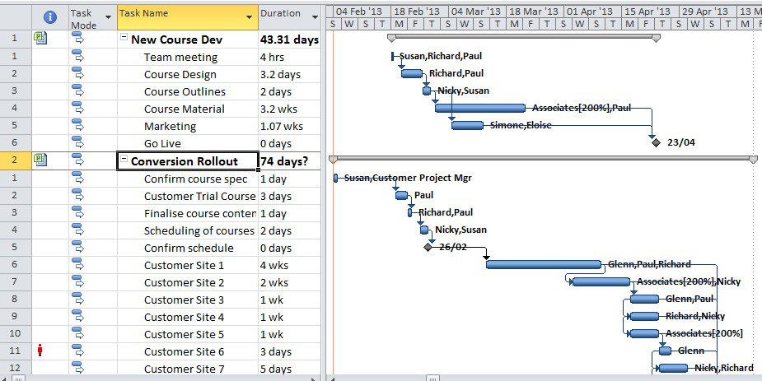
Notes:
not these guys

Slide 4

SELECT NEXT VALUE FOR CUSTID_SEQ;
Notes:
you can’t use SEQUENCE objects because you still have to support SQL Server 2008R2

Slide 5
Stores
StoreID | Location
ERU | East Rutherford, NJ
FOX | Foxborough, MA
SEA | Seattle, WA
OAK | Oakland, CA
Seq
SeqID | LastUsed
Customer | 16
Orders | 1696
StoreID + Customer Sequence number
Customers
CustomerID | Name
ERU10 | Elisha M.
FOX12 | Thomas B.
OAK16 | Derrick C.
SEA3 | Russell W.
Notes:
And an IDENTITY is out of the question too because your PKs aren’t just numbers - they’re concatenated with letters (ABC123)
So what you’re left with is a table with two columns - an ID for the sequence and an ever-increasing number And every time you need to get one of these numbers, you’re dipping into the table.

Slide 6
SELECT LastUsed + 1 FROM Seq WHERE SeqID = ‘CUSTOMER’ (123);
???
Profit! UPDATE Seq SET LastUsed = LastUsed + 1 WHERE SeqID = ‘CUSTOMER’
Notes:
So your developers cook up something like this. And it works…for a while. But then you start getting collisions because your LastUsed keeps getting reused. All that stuff in step 2 is taking so long that another process swoops in and gets the same ID

Slide 7
SELECT LastUsed FROM Seq WHERE SeqID = ‘CUSTOMER’ (123)
UPDATE Seq SET LastUsed = LastUsed + 1 WHERE SeqID = ‘CUSTOMER’
Profit?
Notes:
So you reorder it to this. But this still gets you in trouble because the requests are coming in fast and furious and you still get reuse. You try to move it into a stored procedure to make it run faster but

Slide 8

Notes:
half the shop is allergic to stored procedures so that doesn’t even get off the ground

Slide 9
BEGIN TRANSACTION
SELECT LastUsed FROM Seq WHERE SeqID = ‘CUSTOMER’ (123);
UPDATE Seq SET LastUsed = LastUsed + 1 WHERE SeqID = ‘CUSTOMER’;
???
COMMIT TRANSACTION
Notes:
Then your developers suggest that it all get wrapped up in a transaction. Great! But all that extra work takes time and now we’re blocking everyone from using that sequence table and the user experience is just terrible.

Slide 10
Now What?
¯\_(ツ)_/¯

Slide 11

OUTPUT Clause to the Rescue!
Notes:
No…we need a real hero!

Slide 12


Slide 13
DML Operations Find Their Voice
Insert/Update/Delete
Any number of affected fields
Virtual tables – like triggers

Slide 14
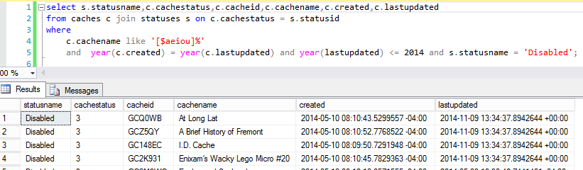
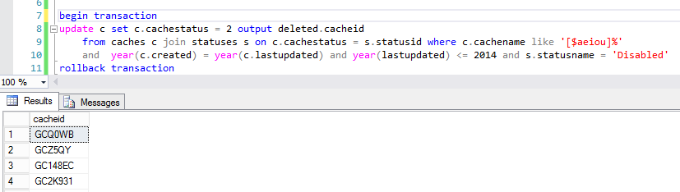
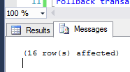
Notes:
Database of geocaches, and for anything whose name starts with a vowel that’s been disabled for 2 or so years, I want to mark them ready for archival
Start with the identification query
And here’s my update. Note the OUTPUT clause
We still get the # of rows affected in SSMS

Slide 15
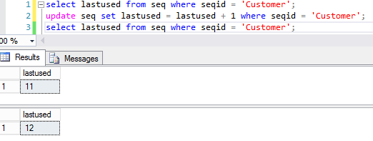
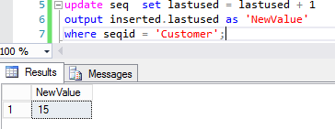
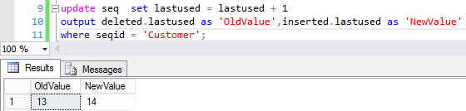
Notes:
The first method resulted in 3X the number of logical reads because we’re doing 3X as many queries
So what does this look like from the application side? I’m going to show it in Powershell because…

Slide 16

Notes:
It’s been 4 slides, I needed another picture

Slide 17
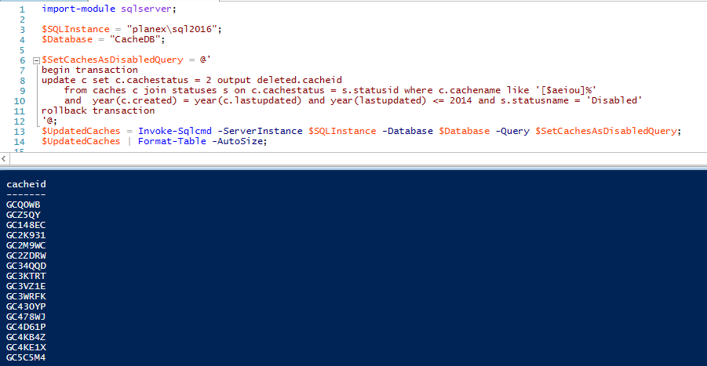
Notes:
Normally with invoke-sqlcmd, you just execute the cmdlet and with an update/insert/delete, you don’t set the result to a variable.
With OUTPUT, the specified fields are written back out to the output stream as an object

Slide 18
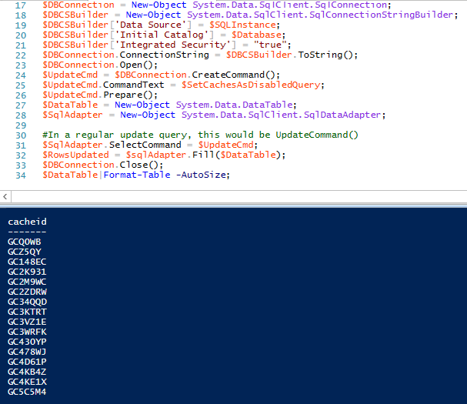
Notes:
ADO.NET method

Slide 19
Saves you work
Saves your database work
Saves your application work
Helps concurrency
When you need it, you need it

